Slide 1

CAPSTONE PROJECT
FINDING BEST LOCATIONS IN ROME TO OPEN A CHINESE RESTAURANT.

Slide 2
CONTEXT:
Opening a restaurant in any city can be real challenge as many parameters should be taken into consideration.
If the restaurant is too far from city center, it will be difficult of access.
If there are too many restaurants in the area, it may be very difficult to get clients.
For solving those issues, a data science project can be quiet useful to derive optimal locations using data.

Slide 3
PROJECT PRESENTATION
In this project, the goal will be to find the best location to open a Chinese restaurant in Rome, Italy.
The idea will be to find a location with less density of restaurant and with no Chinese restaurant nearby. We will focus our studies on the center of the city as it is more likely to get us many clients.
This report will be targeted to stakeholders interested in opening a Chinese restaurant in Rome, Italy.

Slide 4
DATA ACQUISITION AND CLEANING
Defining Piazza dei Cinquecento, 1, 00185 Roma RM as center of city, we can derive its geographical coordinates using Google geocoding API
With the help of Foursquare’s API we get candidate neighborhood centers.
With Google reverse geocoding API we get candidate neighborhood centers addresses.
We got 364 candidate neighborhood centers generated.
(see figure1)

Slide 5
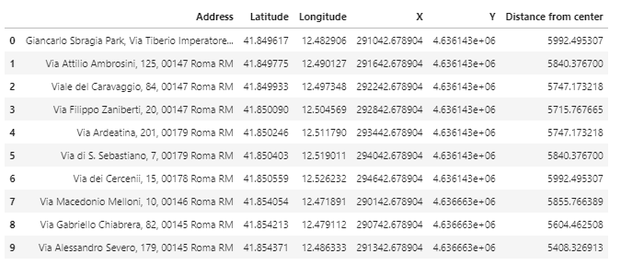
figure1

Slide 6
EXPLANATION OF THE TABLE
The variable distance from center in computed by calculating the distance from a candidate center from the city center. It should not exceed 6km as it is the area on which we focus our study.
Address variable represent the address of the candidate
Longitude and Latitude are Longitude and Latitude of the address
X and Y are the UTM(X) and UTM(Y) coordinates of the address

Slide 7
IDENTIFICATION OF RESTAURANTS
Using Foursquares API we generate restaurants within 6km from my city center and identify Chinese restaurants.
My next step is to identify distances from the area center to the restaurants and find the number of Chinese restaurants in each area.
Total number of restaurants: 1583 Total number of chinese restaurants: 70 Percentage of chinese restaurants: 4.42% Average number of restaurants in neighborhood: 3.771978021978022

Slide 8
Using again the Google reverse geocoding API, we can generate address of all those restaurants along with their geographical coordinates
We can now get total number of restaurants in eich area and derive distance to the nearest Chinese restaurant
This allows us to derive heat maps of all resturants and all chineses restaurants withinin 6 km range from the center of Rome

Slide 9
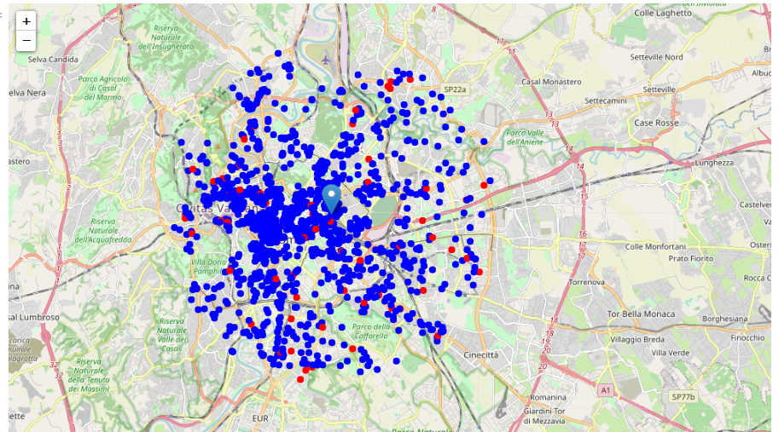
Figure 2: This map shows in blue all restaurants other the Chinese restaurants and in blue are Chinese restaurants
MAP WITH ALL RESTAURANTS WITH CHINESE RESTAURANTS

Slide 10
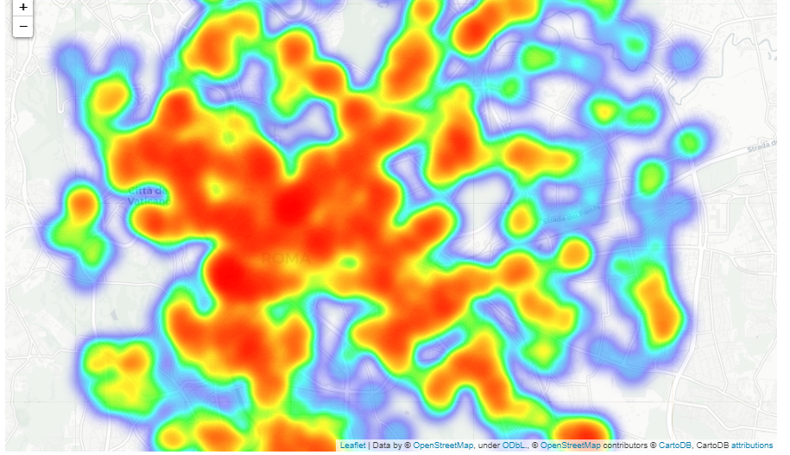
Figure 3: On this heat map of all restaurants, we notice that density is more in center and eastern area is less dense. So most of restaurants are located in the in center of Roma within around 4 to 5 km away from the city center
HEAT MAP ALL RESTAURANTS IN THE CITY CENTER

Slide 11
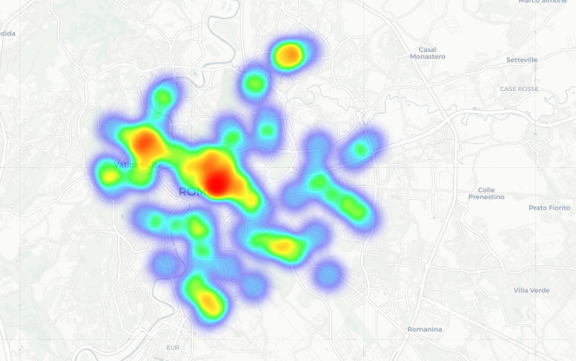
HEAT MAP OF ALL CHINESE RESTAURANTS
Figure 4:
On this graph we can see that most of Chinese restaurants are located 2 to 3 km away from the city center. The density becomes quiet less outside of this area.

Slide 12
DEFINITION OF CRITERIA FOR OPTIMAL LOCATION
Let’s define criterias of good location and derive optimal locations for opening a Chinese restaurant
we derived good locations as Locations with no more than two restaurants and with no Chinese restaurants within 400m
We cluster them and see ideal locations on the map
(See figure5)

Slide 13
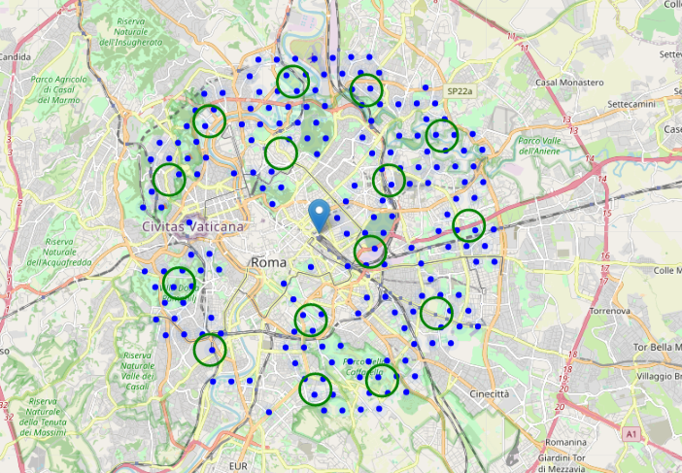
MAP WITH CLUSTERS OF IDEAL LOCATIONS
Figure 5:
We can see here several locations fitting our requirements most of them being within 2 to 6 km away from the center of the city. But there are still a few locations wthin less than 2km away from the center.

Slide 14
DETERMINATION OF TOP 15 LOCATIONS
Taking into consideration the number of restaurants in each locations and the distance from the city center we can now solve the problem which drove us through this analysis.
We will derive 15 optimal locations along with their distance from the city center.

Slide 15
15 OPTIMAL LOCATIONS
Viale Carlo Tommaso Odescalchi, 67, 00147 Roma RM => 5.0km from Piazza dei Cinquecento
Via dei Monti di Pietralata, 127, 00157 Roma RM => 2.9km from Piazza dei Cinquecento
Viale del Casino Algardi, 00164 Roma RM => 4.8km from Piazza dei Cinquecento
Via Salvatore Contarini, 25, 00135 Roma RM => 5.1km from Piazza dei Cinquecento
Via Nicolò Tartaglia, 5, 00197 Roma RM => 2.9km from Piazza dei Cinquecento
Via Casilina, 641, 00177 Roma RM => 4.6km from Piazza dei Cinquecento
Via Federigo Verdinois, 42, 00159 Roma RM => 4.9km from Piazza dei Cinquecento
Viale Val Padana, 135, 00141 Roma RM => 4.9km from Piazza dei Cinquecento
Via di Porta San Sebastiano, 7, 00179 Roma RM => 2.8km from Piazza dei Cinquecento
Antonini, 00149 Roma RM => 5.2km from Piazza dei Cinquecento
Via Bartolomeo Maranta, 2, 00156 Roma RM => 5.1km from Piazza dei Cinquecento
Viale Tito Livio, 67, 00136 Roma RM => 5.2km from Piazza dei Cinquecento
Via Camposampiero, 127, 00191 Roma RM => 5.0km from Piazza dei Cinquecento
Via Pier Andrea Asaccardo, 00159 Roma RM => 1.8km from Piazza dei Cinquecento
Unnamed Road, 00178 Roma RM => 5.2km from Piazza dei Cinquecento

Slide 16
CONCLUSION
The pupose of the study was to derive optimal location to open a restaurant in Roma, within a area no more than 6km away from the city center, with no more than two restaurants and with no Chinese restaurants within 400m.
Final decission on optimal restaurant location will be made by stakeholders based on specific criteria of neighborhoods and locations in every recommended zone, taking into consideration additional factors like attractiveness of each location (proximity to park or water), levels of noise / proximity to major roads, real estate availability, prices, social and economic dynamics of every neighborhood etc.

Slide 17
THIS PROJECT WAS REALLY FUN TO DO AND FORCED ME TO DO SOME RESEARCH MAKING ME DISCOVER SO MUCH.
I thank you for all for reading this report. I hope you enjoyed this project report as I enjoyed writing it.

